Slide 1
ATTENDANCE MANAGEMENT SYSTEM USING CHATBOT
K. V S NEERAJ(170030643)
Y. V SAI ASHISH(170031428)
T. SAHITHI(170031523)
G. DEEPIKA(170031561)

Slide 2
INTRODUCTION
➡ A chatbot is frequently quoted as one of the most leading and promising mediums of interaction between people and machines.
➡ Devising responses to queries in natural dialect is one of the most classic examples of NLP in various domains and user applications. Although, while seeing from an industrial point of view, a chatbot only represents the natural evolution of a
query answering system influencing Natural Language Processing.
➡ Chatbot applications include interactions between humans and different services from different domains, also improving the customer experience.
➡ There are many domains achieving huge profits from installing chatbots. Some of these top domains include are retail, e-commerce, entertainment, hospitality, finance, health care sector, news, government and many more.

Slide 3
PROBLEM STATEMENT
Creating a fully efficient Chat Bot that includes features like sending an electronic mail and a whatsapp message to a particular recipient, playing songs of choice, giving an optimal result of user query from Google and more importantly make taking attendance easier. This task includes taking pictures of the candidate and providing attendance through facial recognition.

Slide 4
METHODOLOGY
Sending WHATSAPP Messages :
➡For this functionality selenium package and webdriver tool is used
➡Selenium is a open-source testing framework used to validate web applications. Primarly selenium is developed by Jason Huggings in 2004 and webdriver is created by Simon Stewart which is the first cross-platform testing framework that could control the browser from the OS level. Selenium webdriver can be used to automate web application testing and verifying
➡Web driver is used to open the web application of whatsapp after the web application is opened and we have scanned the QR code.Whatsapp is always the best interface for communicating with closed ones. Chatbot also makes this process simpler.
Sending Mails :
➡ For this functionality we have used smtplib library.
➡ Simple Mail Transfer Protocol is a protocol used to send e-mails and also routing of e-mails between the mail servers.
➡ In our application “smtplib1” module is used for sending mails by getting an SMTP client session object.Sending and Receiving emails can also be performed smoothly with a chatbot.
➡ Automation of the emails helps in reducing manual work and also performs actions without causing any ambiguity.The content of the email and receiver’s information can be disclosed with the chatbot with voice commands instead of typing.

Slide 5
OS Accessing :
➡For this functionality OS module in python.
➡OS module includes and provides functionality of interacting with the operating system, It is one of the standard python utility modules. The OS module provides with a access method to test path of the file and also the Permissions of the file. It also used to test
➡whether the invoking user has specified access to the path.
➡After checking the access we can get to read or write the file based on the permissions. Sometimes it becomes difficult for the user to search for a particular file's location and access it. It requires a lot of manual work and needs to dig deeper.
➡This chatbot will be able to locate any file and retrieve it for the user and it would take less time compared with searching every folder. It also has access to the user's playlist so when the user asks for any song or movie it instantly plays it.
Web-Searching:
➡For all the user queries that need to search the web we have used Wolfram Alpha API. ➡Wolfram alpha is a Computational Knowledge engine also known as semantic search engine. Unlike the conventional search engine this Wolfram alpha provides us a complete list and tables to provide users with specific answers to their queries. ➡ When the chatbot is been asked with a query it gives an optimal result to user which will be very helpful at that point. ➡ It parses the query into pieces and searches for each and every word and gets the solution for it.

Slide 6
Emotion Detection :
➡For this Functionality we have used Keras and OpenCV modules.
➡Keras is an open-source neural network library François Chollet in the view of it to be modular, fast and easy to use. ➡It is written in Python. It runs on top of TensorFlow or Theano. It is high level API Wrapper and uses another library called “Backend” to perform low-level computations.
➡The training of the images is done in such a way that it takes the measurement of the face captured in those images and stores the values of these predicted measures. ➡And if the student appears again it checks with the predicted measures stored in the xml file and after running the course it displays the information of the student instantly.

Slide 7
ATTENDANCE MANAGEMENT SYSTEM
➡Attendance Management is the main backbone of the entire project and with the help of chatbot the organization will be able to record every students attendance without any confusion, errors and human involvement.
➡For this Functionality we have used OpenCV, Tkinter and pandas modules.
➡OpenCV is a open source library for computer vision, machine-learning and image-processing and also plays a major role real-time operations in present day systems.
➡If the student is new to particular session or organization, the chatbot notes the details of the student and captures the images of students face.
➡It takes 61 images of the particular student in different poses and all are stored in the database.
➡The training of the images is done in such a way that it takes the measurement of the face captured in those images and stores the values of these predicted measures.
➡Once the prediction of face is completed with help of the measurements stored, it takes the attendance for that particular student in an excel sheet storing the details of the student as well as the date and time of when the attendance is been taken.
➡It segregates the attendance by the date and time so that it doesn’t gets mixed up.

Slide 8
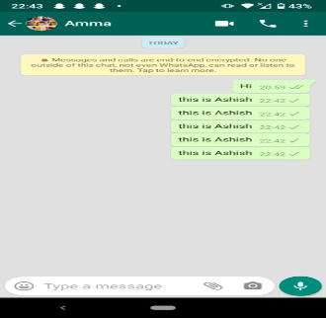
RESULTS
➡ Sending Message through Whatsapp

Slide 9
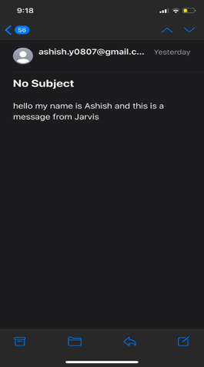
➡Sending Message via email

Slide 10
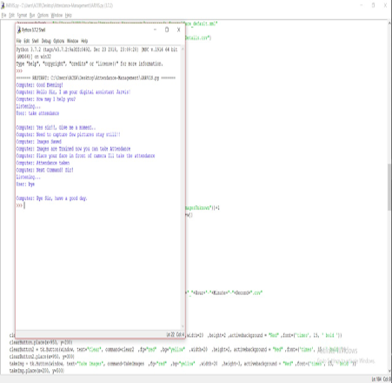
➡ Attendance Management System

Slide 11
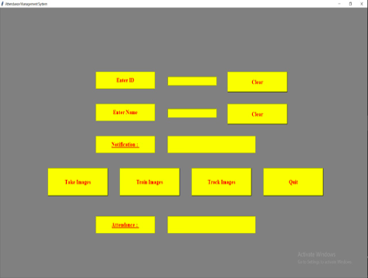
➡Page for taking attendance

Slide 12
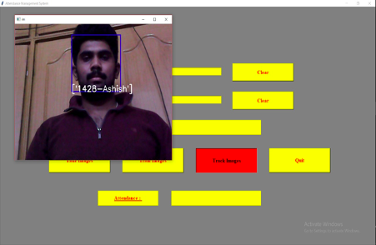
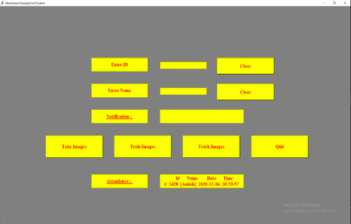
➡Taking Attendance by taking images

Slide 13
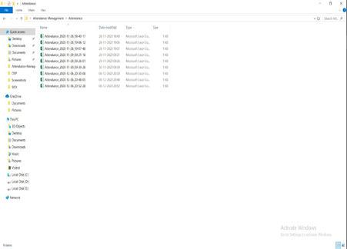
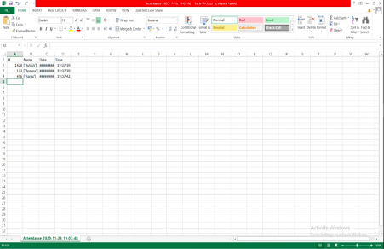
➡Saving Attendance in Excel Sheet

Slide 14
CONCLUSION
Chatbots with artificial intelligence are dramatically changing businesses. There is a vast range of chatbot building platforms that are available for various fields, such as ticket inquiry, retail, banking, traveling, healthcare, counselling, and so on. It takes practice and a lot of understanding of various concepts to get the design work properly and build chatbots that give users a good experience. Even the users want to complete the jobs by interacting with these chatbots without worrying much and with a smile on their face. The Attendance feature added to our chatbot will help the different organizations to consider the attendance of every student and recording their information without any human stress and any ambiguity. Also, we will be developing this chatbot into a personal assistant that acts as a counsellor and gives people advice. In this way, chatbots reach out to a large audience and become more effective than humans..

Slide 15


